Slide 1
LO2 Assessment
Interactive Media
Unit 1

Slide 2
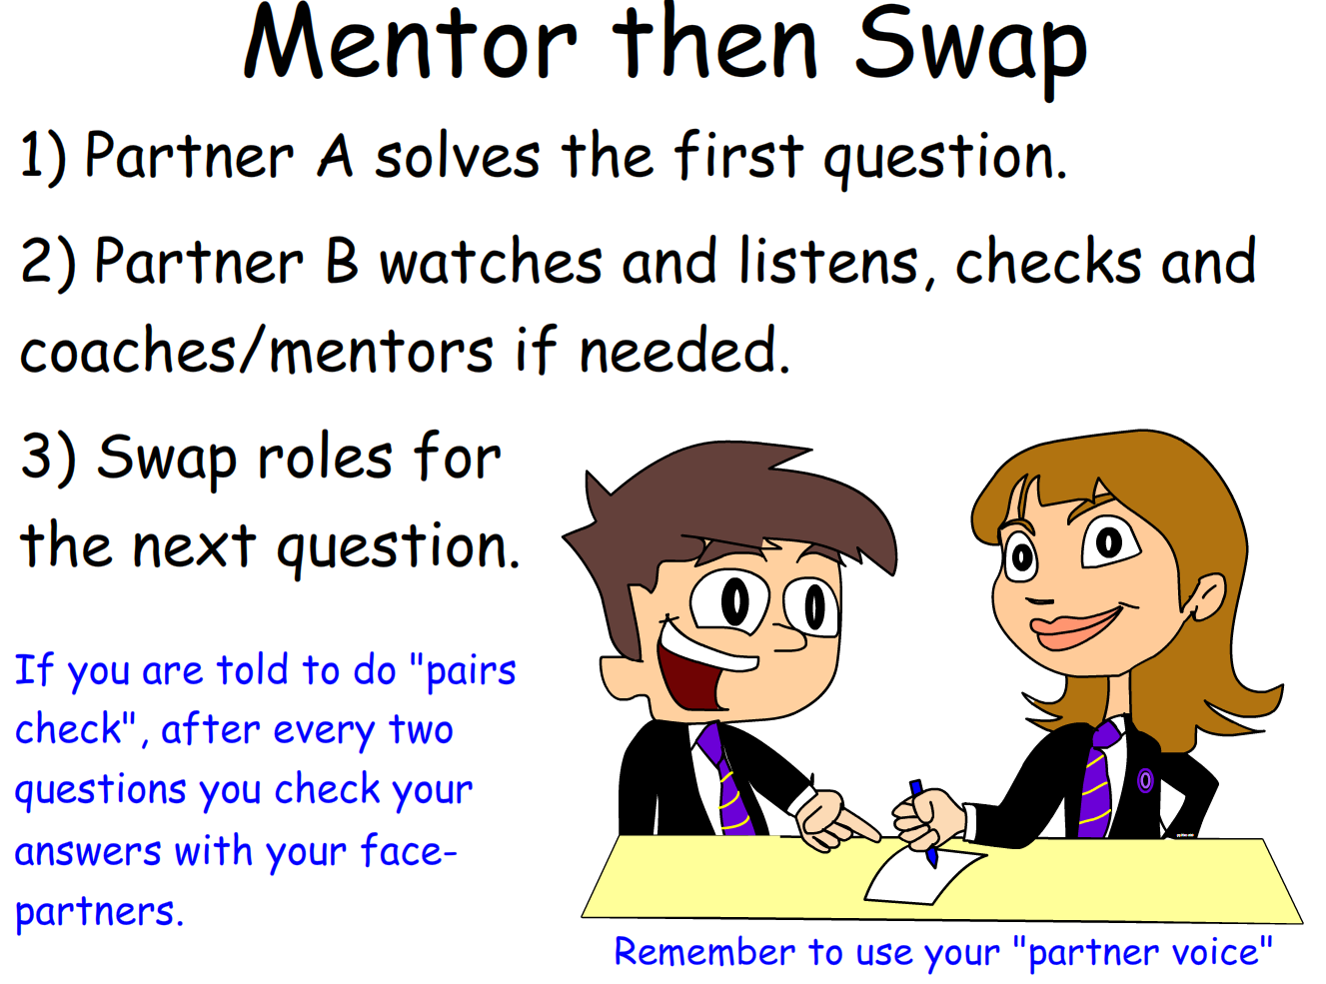
Starter – 5 Minutes
Log in and fill your answers into your worksheet.
List the different skills and techniques used to produce a website.
Explain how the target audience may affect the final product.

Slide 3

Learning Outcomes
Aspire to ……
 | Explain how to clearly evidence experimentation to prove it has links to a given brief.
Challenge to……
 | Describe how to focus experimentation further towards a brief.
 | Understand how to complete purposeful experimentation to fit a brief.

Slide 4
Assessment Brief
You are working as part of a marketing team for a televised talent show. As a specialist in interactive media production you have been asked to produce an interactive media product to publicise the show.
However the talent show producers want to be sure you “know your stuff”.
To do this, you need to show experimentation with processes and techniques needed for the development of an interactive media product.

Slide 5
What you will Evidence
Your experimentation must show evidence of one or more of the following:
Image manipulation
Website authoring
Game development
Software development
Your work will be presented as your experimentation files, e.g. Photoshop files and a written report, however visual elements, e.g. pictures and diagrams are expected.

Slide 6

Grading Criteria
Distinction: Carries out thorough experimentation with clear evidence of how this has been used in relation to the brief.
Merit: Carries out focused experimentation with evidence of how this has been used in relation to the brief.
Pass: Carries out purposeful experimentation with some links to the brief.

